Slide 1
Chapter 4 CPU DESIGN

Slide 2
Contents:
Introduction to CPU
Specifying a CPU
Design and Implementation of a Very Simple and Relatively Simple CPU
Instruction Execution, Fetch, Decode , Data path
ALU Design
Designing Hardwired Control Unit
Design Verification

Slide 3
4.1 Introduction to CPU
Central Processing Unit
CPU = ALU + Registers + Control Unit
Performs sequences of microoperations needed to perform fetch, decode and execute cycles of every instructions in CPU instruction set.

Slide 4
4.2 Specifying a CPU
The first step in designing CPU is to determine its applications. The key is to match the capabilities of the CPU to the tasks it will perform.
Second step is to design a Instruction Set Architecture (ISA) which can handle the given tasks.
Third step is to design State diagram for CPU. Here the different microoperation are shown, which are performed during each stat and the conditions that cause CPU to go from one state to another. CPU is a complex Finite State Machine.
Then, specifying the steps the CPU must perform in order to fetch, decode and execute every instructions in its instruction set.

Slide 5
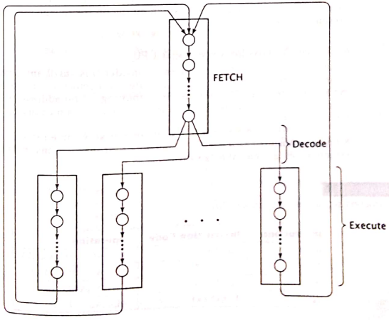
In general, a CPU performs following sequence of operations.
Fetch Cycle: Fetching an instruction from memory, then go to decode cycle.
Decode Cycle: Decoding an instruction- that is, determine which instruction has been fetched.
Execute cycle: Executing the instruction . Then go to the fetch cycle and fetch the next instruction.

Slide 6
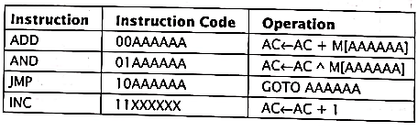
4.3 Design and Implementation of a Very Simple and Relatively Simple CPU
To illustrate the CPU design process,
lets us consider:
A small and somewhat impractical CPU.
It can access 64 bytes of memory, each byte being 8 bits wide.
The CPU does this by outputting a 6-bit address on its output pins A[5..0], and reading in the 8-bit value from memory on its inputs D[7…0].
The CPU has: one programmable register, 8-bit accumulator (AC).
It has only four instructions in its instruction set.

Slide 7
Design and Implementation of a Very Simple and Relatively Simple CPU
In addition to AC, the CPU contains the following registers:
Address Register (AR):
6-bit
Supplies an address to memory via A[5..0].
Program Counter(PC):
6-bit
Contains the address of the next instruction to be executed.
Data Register(DR):
8-bit
Receives instructions and data from memory via D[7…0]
Instruction Register(IR):
2-bit
Stores the opcode portion of the instruction code fetched from memory.

Slide 8
4.4 Instruction Execution, Fetch, Decode and Datapath
Fetching instructions from memory
Decoding instructions
Executing instructions
Constructing Datapath

Slide 9
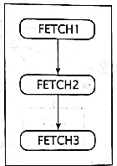
1. Fetching instructions from Memory.
The address of instruction to be fetched is stored in the PC.
Since, address register (AR) supplies an address to memory through A [5……0] pins
Firstly, copy the content of PC to AR. Thus, the first state of the fetch cycle is:
Fetch 1: AR ← PC
Next, the CPU reads the instructions from the memory. The CPU must assert READ signal, which is output from the CPU to memory. This causes memory to store in Data Register (DR).
Fetch 2: DR ←M
PC ←PC + 1
Finally, two higher order bits of DR are copied into Instruction Register (IR); these two bits indicate which instruction is to be executed,
and the CPU copies the lower order 6-bit of DR into AR.
Fetch 3: IR ←DR [7,6]
AR ← DR [5….0]
The state diagram for the fetch cycle is shown aside.

Slide 10
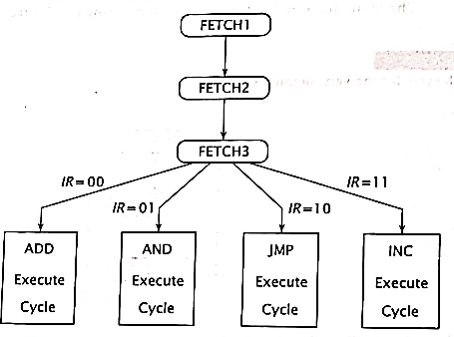
2. Decoding instructions
After CPU has fetched an instruction from memory, it must determine which instruction it has fetched so that it may invoke the correct execute routine.
For this CPU, there are four instructions and thus, four executer routines.
The value in IR (00,01,10 or 11) determines which execute routine is invoked.

Slide 11
3. Executing instructions
To complete the state diagram for this CPU, we must develop the state diagram for each execute routine.
Now, we design the portion of the state diagram for each routine and the overall design for the CPU.
The state diagrams for the individual execute routines are fairly simple, so they are only included in the diagram of the finite state machine for the entire CPU.
a) ADD instruction
To perform ADD instruction, CPU must :
First, fetch one operand from memory.
Then add this operand to current contents in AC and store result back in the AC.
ADD1: DR←M
ADD2: AC←AC+DR
b) AND instruction
Virtually similar to ADD instruction.
First, fetch an operand from memory.
Logically AND the two values and store it in AC.
AND1: DR←M
AND2: AC← AC^DR
c) JMP instruction
The address to which the CPU must jump is copied into the PC.
Then CPU fetches the next instruction.
JMP1: PC← DR [5..0]
d) INC instruction
CPU simply adds 1 to contents of AC and goes to fetch routine.
INC1: AC← AC + 1

Slide 12
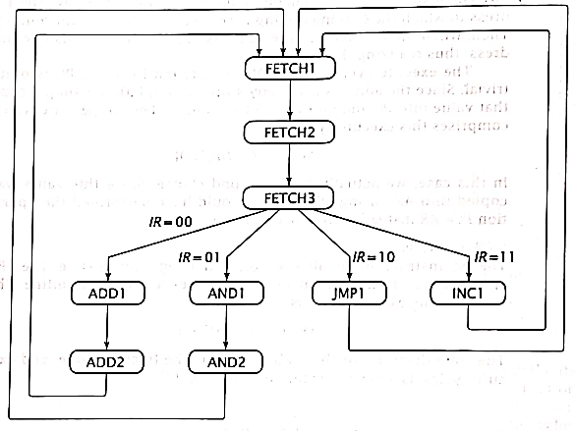
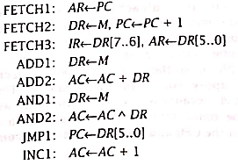
Establishing required Data paths
The state diagram and register transfers specify what must be done in order to realize this CPU.
Now we must design the CPU so that it actually does these things.
First, we look at what data transfers can take place and design the internal data paths of the CPU so this can be done.
The operations associated with each state for this CPU are:

Slide 13
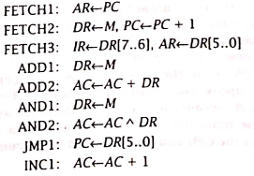
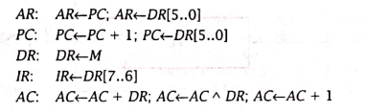
To design the data paths, we can take one of two approaches.
Create direct paths between each pair of components that transfer data.
Create a bus within the CPU and route data between components via the bus.
Now we regroup the operations, without regard for the cycles in which they occur, by the register whose contents they modify. This result in the following:

Slide 14
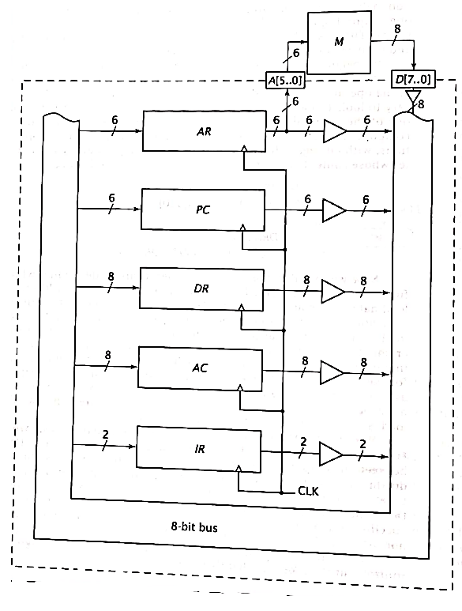
AR, DR and IR always load data from some other component.
We connect every component to the system bus, as shown in figure.
We include tri-state buffers to restrict data being placed all the times by everyone.
Also, the output of AR are connected to pins A[5..0], as required in the CPU specification.

Slide 15

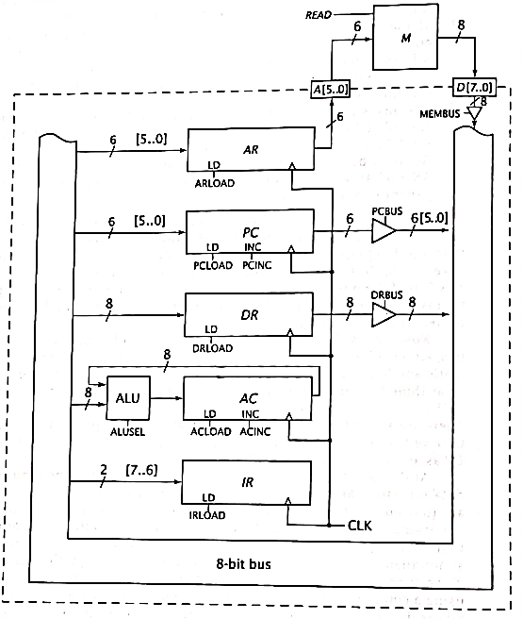
AC can load in one of two values, either AC+DR or AC^DR.
The CPU must incorporate some arithmetic and logic circuitry to generate these values.
When ALUSEL = 0, the output of ALU is arithmetic sum of its input, (i.e. AC+DR)
When ALUSEL = 1, the output of ALU is logical AND of its input. (i.e. AC^DR)

Slide 16
4.5 ALU Design
The circuit diagram for the relatively simple CPU is shown in figure below:

Slide 17
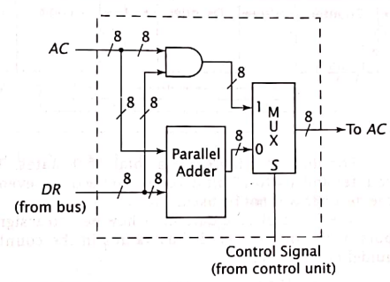
ALU for relatively simple CPU
The ALU for this CPU performs only two functions:
Adds its two inputs or
logically ANDs its two inputs.
The simplest way to design this ALU is to create separate hardware to perform each function and then use a multiplexer to output one of the two results.
The addition is implemented using a standard 8-bit parallel adder.
The logical AND operation is implemented using eight bits 2-input AND gates.
The outputs of the parallel adder and the AND gates are input to an 8-bit 2 to 1 multiplexer.
The control unit of the MUX is called S (for select).
Figure: ALU Design

Slide 19
Summary:
The state diagram and RTL code for the micro-operation for our required CPU is as shown below:
RTL Code:
State Diagram:

Slide 20
Summary (Contd.)
After regrouping the operations, the RTL codes are:
Considering the regrouped RTL codes, our required register organization and datapath is as shown in the figure aside.

Slide 21
Summary (Contd.)
The ALU for this CPU is as shown below:
Figure: ALU Design

Slide 22
4.6 Designing Hardwired Control Unit
After designing the CPU for every operation necessary to fetch, decode and execute the entire instruction set, the next step is to design the circuit to generate control signals to cause operation to occur in proper sequence. This is control unit.
There are two methods:
Hardwired control
Microprogrammed control
Hardwired control:
It uses sequential and combinational logic to generate control signals.
Microprogrammed control:
It uses a lookup memory to output the control signals.

Slide 23
4.6 Designing Hardwired Control Unit (Contd.)
Here, we focus on hardwired control.
The simple control unit has three components:
Counter: it contains current state.
Decoder: It takes current state and generates individual signals for each state.
Combinational Logic: It takes the individual state signals and generate the control signals for each component as well as the signals to control the counter.
These signals cause control unit to traverse the states in proper order.

Slide 24
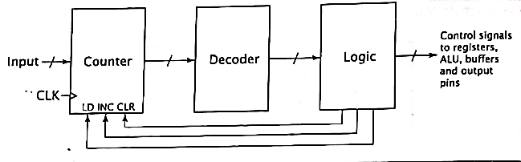
Generic Hardwired Control Unit
The CPU that we have designed has 9 total states. So, a 4-bit counter and 4:16 decoder are needed. Here, seven of the outputs of the decode will not be used.
Input: in input, states are provided.
CLK: a clock signal
CLR: CLR input is used to reach the state needed.
INC: use INC input of counter to traverse the states.
LD: use LD input to reach the proper execute routine.

Slide 25
Mapping Logic
For Reference:
To make the function simple as possible:
Consider the possible mapping 10[IR] i.e. if IR=00, the input to counter is 1000. For IR=01, the input is 1001 and so on.
So, the counter values will be:
Here, the problem arises.
The ADD1 and ADD2 operations cannot be performed sequentially.
Since state ADD1 has a counter value of 8 and state AND1 has a counter value of 9, there is no counter value that has to be assigned to ADD2. (not best solution)
So, we look for alternative solution.
IR | Counter value | state
00 | 1000 (8) | ADD1
01 | 1001 (9) | AND1
10 | 1010 (10) | JMP1
11 | 1011 (11) | INC1
Table: Counter values for the proposed mapping function

Slide 26
Now if we mapping function as: 1[IR]0, which results in counter values of:
Now, we can assign counter value 9 to ADD2 and 11 to AND2
This enables to perform sequentially.
IR | Counter | Value | state
00 | 1 0 0 0 (8) | 8 | ADD1
01 | 1 0 1 0 (10) | 10 | AND1
10 | 1 1 0 0 (12) | 12 | JMP1
11 | 1 1 1 0 (14) | 14 | INC1

Slide 27
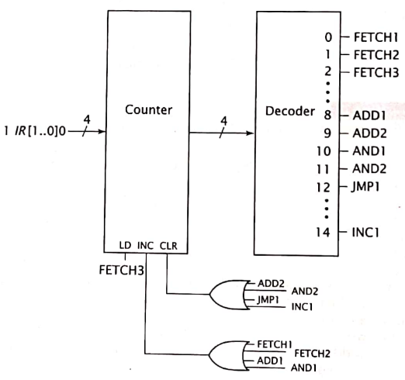
For Counter, INC, CLR and LD signals are needed.
INC is asserted when control unit is traversing sequential states, during Fetch1, Fetch2, JMP1 and INC1
LD is asserted at end of fetch cycle during stateFetch3.
CLR is asserted at the end of each execute cycle to return to fetch cycle. This happens during ADD2, AND2, JMP1 and INC1
So, a complete hardwired control unit is:

Slide 28
Summary:
.
The CPU that we have designed has 9 total states. So, a 4-bit counter and 4:16 decoder are needed. Here, seven of the outputs of the decode will not be used.
The general block diagram for our required Hardwired Control Unit is as given below:
Our CPU’s state diagram is as shown below:
Figure: General Block diagram of Control Unit
Figure: State diagram

Slide 29
Summary (contd.)
Now if we mapping function as: 1[IR]0, which results in counter values of:
Now, we can assign counter value 9 to ADD2 and 11 to AND2
This enables to perform sequentially.
So, a complete hardwired control unit is:
IR | Counter | Value | state
00 | 1 0 0 0 (8) | 8 | ADD1
01 | 1 0 1 0 (10) | 10 | AND1
10 | 1 1 0 0 (12) | 12 | JMP1
11 | 1 1 1 0 (14) | 14 | INC1
Figure: Hardwired Unit for our CPU

Slide 30
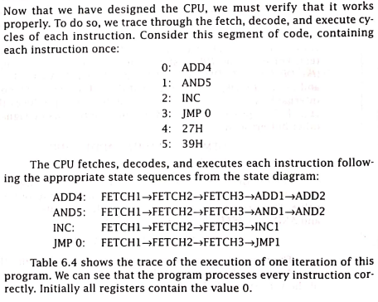
4.6 Design Verification

Slide 31


After CPU have been designed, we must verify that it works properly.
To do so, we trace through the fetch, decode and execute cycles of each instruction.
Consider this segment of code, containing each instruction once:
The CPU fetches, decodes and executes each instruction following the appropriate state sequences from the state diagram:

Slide 32

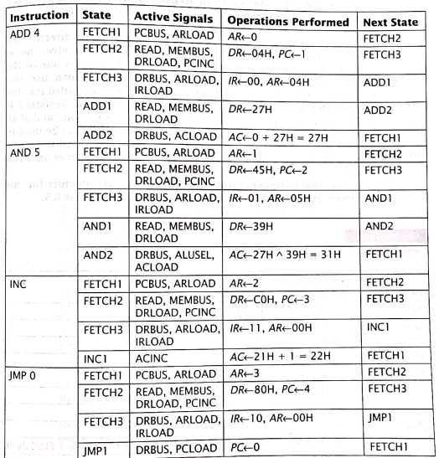
Table here shows the trace of the execution of one iteration of this program.
We can see that the program processes every instruction correctly.
Initially, all registers contain the value 0.

Slide 33
Some Few Worked out Examples:

Slide 34
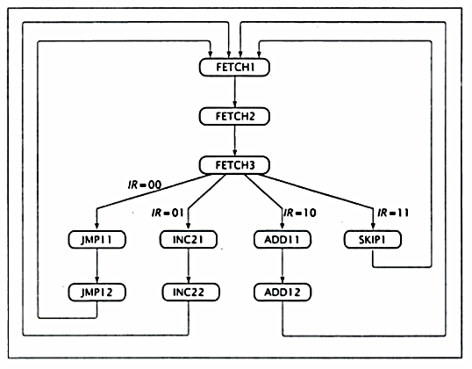
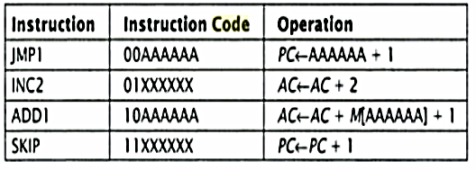
Example 1:
Design CPU for below:
Solution:
The state diagram and RTL code for the micro-operation for our required CPU is as shown below:
Here, micro-operations are:
Fetch 1: AR ← PC
Fetch 2: DR ←M, PC ← PC + 1
Fetch 3: IR ← DR[7,6], AR ← DR[5….0]
JMP11: PC ←AR
JMP12: PC ← PC +1
INC21: AC ←AC +1
INC22: AC ←AC +1
ADD11: DR ← M, AC ←AC + 1
ADD12: AC ← AC + DR
SKIP1: PC ← PC + 1
Figure: State diagram

Slide 35
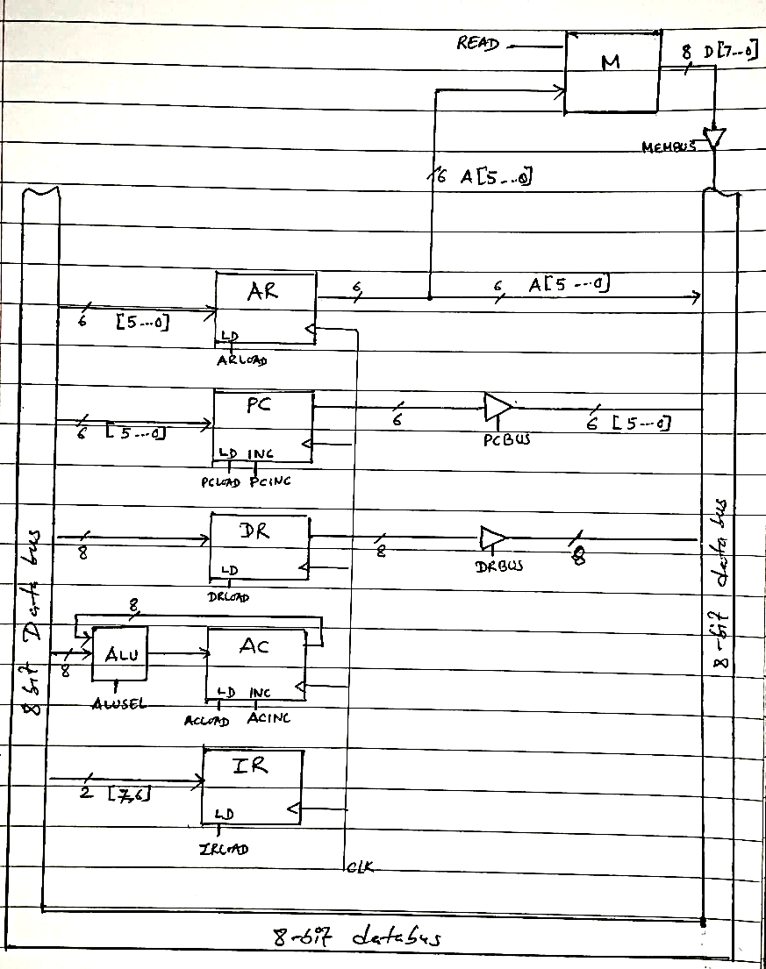
After regrouping the operations, the RTL codes are:
Considering the regrouped RTL codes, our required register organization and datapath is as shown in the figure aside.
Fetch 1: AR ← PC
Fetch 2: DR ←M, PC ← PC + 1
Fetch 3: IR ← DR[7,6], AR ← DR[5….0]
JMP11: PC ←AR
JMP12: PC ← PC +1
INC21: AC ←AC +1
INC22: AC ←AC +1
ADD11: DR ← M, AC ←AC + 1
ADD12: AC ← AC + DR
SKIP1: PC ← PC + 1
AR: AR ← PC , AR←DR[5..0]
PC: PC ← PC + 1 , PC←AR
DR: DR←M
AC: AC ←AC +1 , AC ← AC + DR
IR: IR ← DR[7,6]
ARBUS

Slide 36
ALU section:
The ALU for this CPU is as shown below:
MUX
AC
0
1
Parallel Adder
To AC
DR
S
ALUSEL
Control Signal from CU
Figure: ALU Design

Slide 37
Hardware Unit
.
The CPU that we have designed has 10 total states. So, a 4-bit counter and 4:16 decoder are needed. Here, six of the outputs of the decode will not be used.
The general block diagram for our required Hardwired Control Unit is as given below:
Our CPU’s state diagram is as shown below:
Figure: General Block diagram of Control Unit
Figure: State diagram

Slide 38
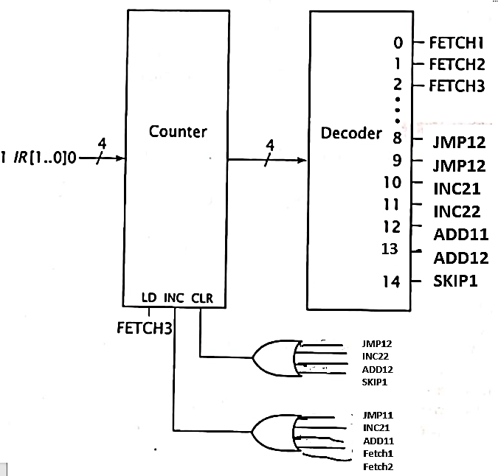
Now if we mapping function as: 1[IR]0, which results in counter values of:
Now, we can assign counter value 9 to JMP12 and 11 to INC22
This enables to perform sequentially.
So, a complete hardwired control unit is:
IR | Counter | Value | state
00 | 1 0 0 0 (8) | 8 | JMP11
01 | 1 0 1 0 (10) | 10 | INC21
10 | 1 1 0 0 (12) | 12 | ADD11
11 | 1 1 1 0 (14) | 14 | SKIP1
JMP11
Figure: Hardwired Unit for our CPU

Slide 39
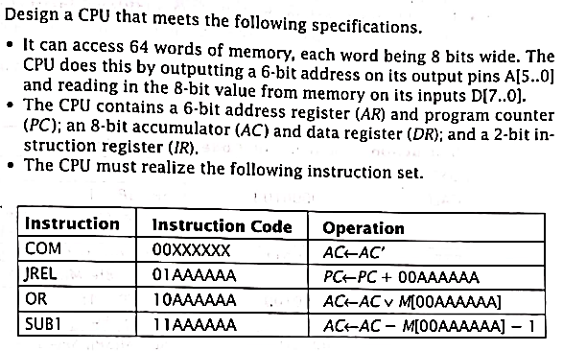
Example 2: Design a CPU that meets the following specifications.

Slide 40
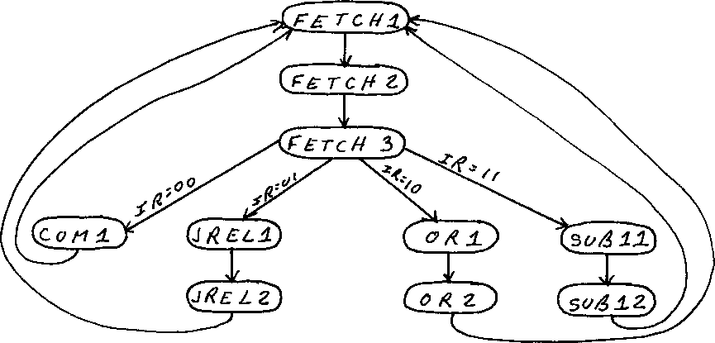
Solution: State diagram and RTL code:
FETCH1: AR ← PC
FETCH2: DR ← M, PC ← PC + 1
FETCH3: IR ← DR[7..6], AR ← DR[5..0]
COM1: AC ← AC'
JREL1: DR ← M
JREL2: PC ← PC + DR[5..0]
OR1: DR ← M
OR2: AC ← AC Ú DR
SUB11: DR ← M
SUB12: AC ← AC + DR'

Slide 41
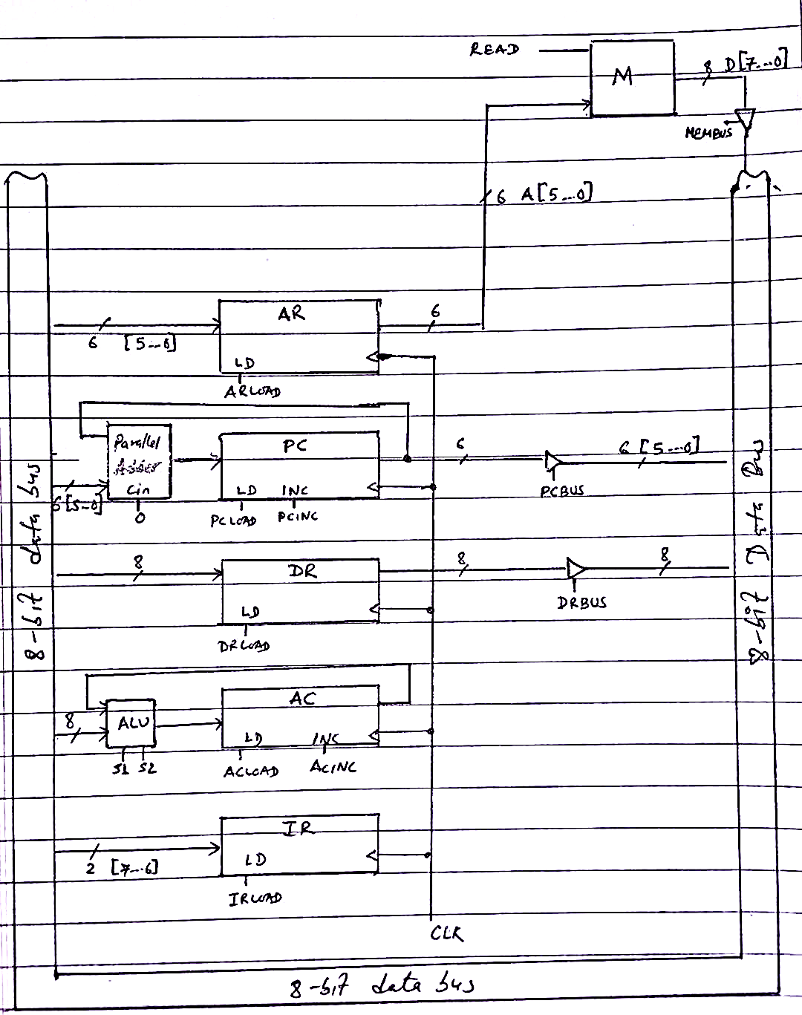
After regrouping the operations, the RTL codes are:
Considering the regrouped RTL codes, our required register organization and datapath is as shown in the figure aside.
FETCH1 : AR ← PC
FETCH2 : DR ← M, PC ← PC + 1
FETCH3 : IR ← DR[7..6], AR ← DR[5..0]
COM1 : AC ← AC'
JREL1 : DR ← M
JREL2 : PC ← PC + DR[5..0]
OR1 : DR ← M
OR2 : AC ← AC U DR
SUB11 : DR ← M
SUB12 : AC ← AC + DR'
AR: AR ← PC , AR←DR[5..0]
PC: PC ← PC + 1 , PC←PC+DR[5..0]
DR: DR←M
AC: AC←AC’ , AC ← AC U DR, AC ← AC + DR’
IR: IR ← DR[7,6]

Slide 42
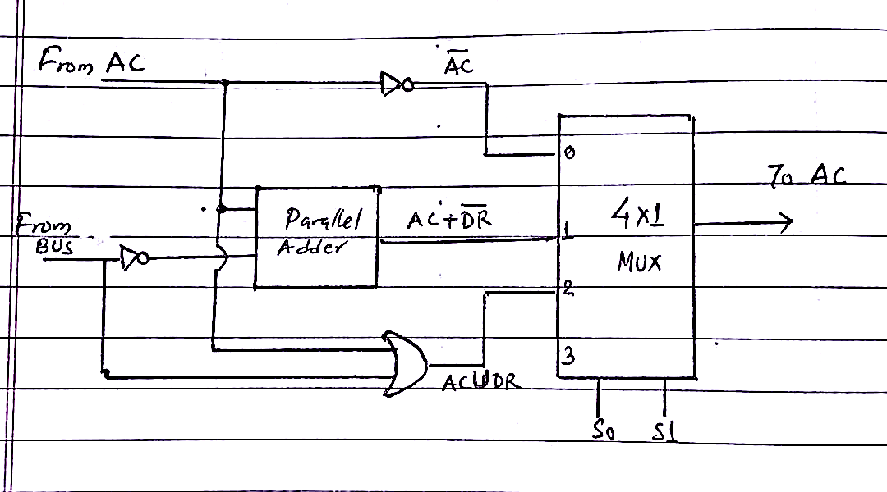
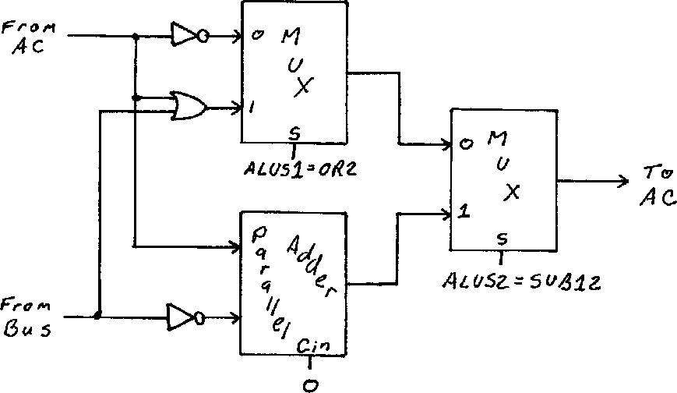
ALU section:
DR
OR

Slide 43
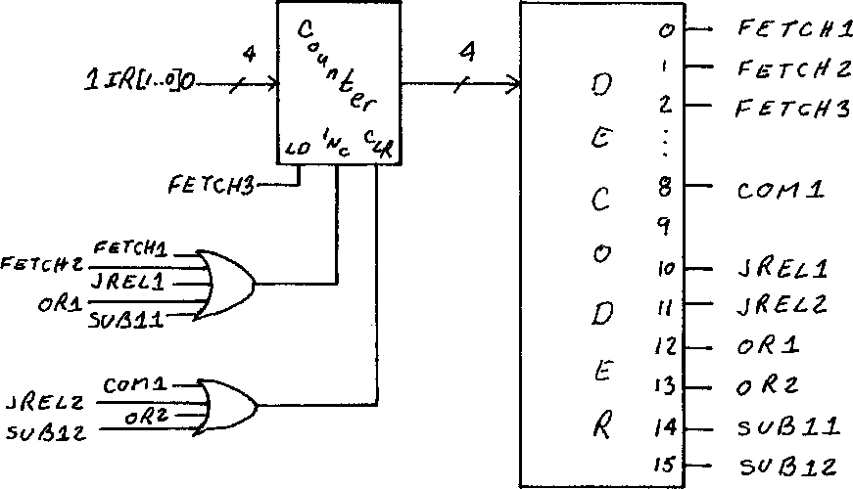
Control unit:
Note: Write short explanation as before.

Slide 44
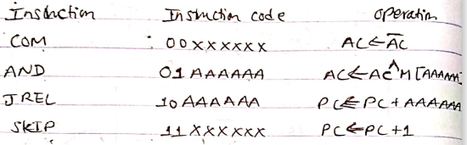
Example 3:
Design a CPU that has 6-bit address register (AR), 6-bit program counter (PC), 8-bit data register (DR) and 2-bit instruction register (IR). The CPU must execute the following instructions:
Show the RTL code for fetch and execute cycles for each instruction and draw state diagram.
Show the final register section
Show the ALU Design
Show hardwired control unit for same CPU.

Slide 45
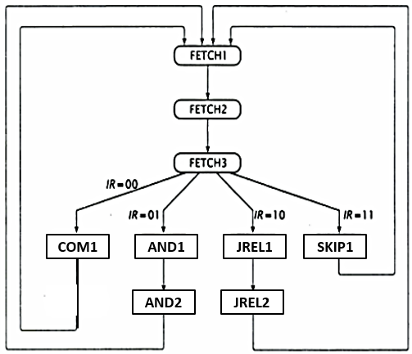
Solution:
RTL code and State diagram
Fetch1 : AR← PC
Fetch2 : DR← M, PC← PC+1
Fetch3 : IR← DR [7-6], AR←DR[5…0]
COM1 : AC← AC’
AND1 : DR←M
AND2 : AC← AC^DR
JREL1 : AR←DR [5..0]
JREL2 : PC←PC+AR
SKIP1 : PC←PC+1
Notes:
JREL

Slide 46
After regrouping the operations, the RTL codes are:
Considering the regrouped RTL codes, our required register organization and datapath is as shown in the figure aside.
Fetch1 : AR← PC
Fetch2 : DR← M, PC← PC+1
Fetch3 : IR← DR [7-6], AR←DR[5…0]
COM1 : AC← AC’
AND1 : DR←M
AND2 : AC← AC^DR
JREL1 : AR←DR [5..0]
JREL2 : PC←PC+AR
SKIP1 : PC←PC+1
AR: AR ← PC , AR←DR[5..0]
PC: PC ← PC + 1 , PC←PC+AR
DR: DR←M
AC: AC←AC’ , AC ← AC ^ DR
IR: IR ← DR[7,6]
ARBUS
ALSUSEL

Slide 47
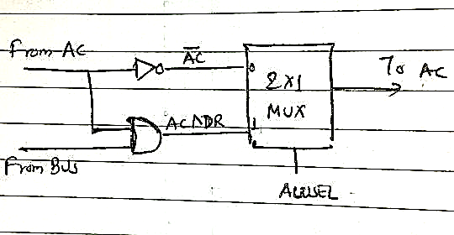
ALU section:
DR
OR

Slide 48
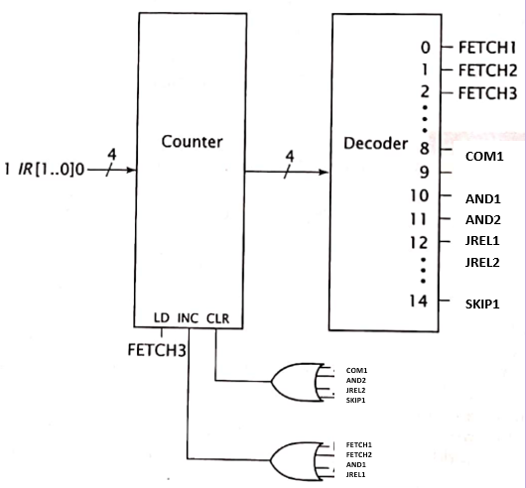
Control unit:
Note: Write short explanation as before.

Slide 49
Exam Questions:

Slide 50
Exam Questions:
1. a) There is a Very Simple CPU for the given set of Instructions: [PU 2017 Fall]
LDA (Load Accumulator with a value from memory) with opcode 00;
AND (performing and operation to the content of accumulator with the value at some memory address) with opcode 01;
SKIP (skipping an instruction) with opcode 10;
DEC (decrementing the value at accumulator) with opcode 11;
Let the instruction width be 8 bits and address is 6 bits. Design the CPU’s Register section, state diagram and ALU.
b) Design the hardwired control unit for the CPU described in above question. [PU 2017 Fall]

Slide 51
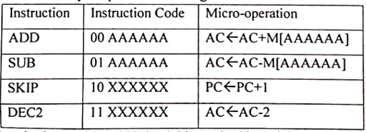
2. a) There is a very simple CPU for the given set of Instruction: [PU 2017 Spring]
Let the instruction width be 8 bits and address is 6 bits. Design the CPU’s register section, state diagram and ALU.
b) Design the hardwired control unit for the CPU described in above question. [PU 2017 Spring]

Slide 52
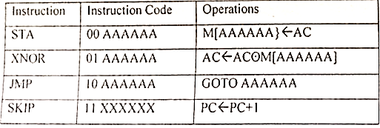
3. a) There is a very simple CPU for the given set of Instruction: [PU 2018 Fall]
Let the instruction width be 8 bits and address is 6 bits. Design the CPU’s register section, state diagram and ALU.
b) Design the hardwired control unit for the CPU described in above question. [PU 2018 Fall]

Slide 53
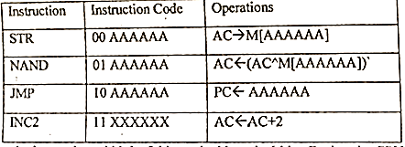
4. a) There is a very simple CPU for the given set of Instruction: [PU 2018 Spring]
Let the instruction width be 8 bits and address is 6 bits. Design the CPU’s register section, state diagram and ALU.
b) Design the hardwired control unit for the CPU described in above question. [PU 2018 Spring]

Slide 54
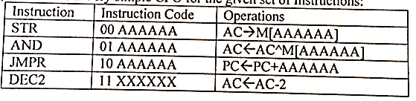
5. a) There is a very simple CPU for the given set of Instruction: [PU 2019 Spring]
Let the instruction width be 8 bits and address is 6 bits. Design the CPU’s register section, state diagram and ALU.
b) Design the hardwired control unit for the CPU described in above question. [PU 2019 Spring]

Slide 55
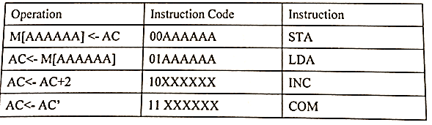
6. For a very simple CPU, has the following instruction set. Show the state diagram, register section, ALU design. [PU 2020 Spring]

Slide 56
End of chapter 4

